Slide 1

Wearable Electronics for Sports
VERSUS
Sona College of Technology

Slide 2
VERSUS
Surya Narayanan CS
B.E – 3rd semester
ECE Department
I am ready to apply my knowledge into practical
Has won the Smart-O-Thon (Hackathon) conducted by Code Chef(2021).
Has won the Kode-!O-Thon(Hackathon) conducted by Anna University (2022).
Participated In the Hack-A-Web contest and shortlisted in the top 100 teams.
Sakthi C
B.E – 3rd semester
ECE Department
I'm interested in IoT and embedded systems .Also presented 15 papers In paper presentation regarding embedded systems.
Notes:
Mention the details of the participants

Slide 3
Wearable Electronics for Sports
Challenges undertaken: 1,3 & 4
Broad description of Proposed solution:
We have introduced a interesting and compact easily wearable device “Versus” that monitors the movement and health of the players and it can be lively monitored through the webpage that we will be developing and if any abnormalities in the player’s health, it alerts the caretaker or the coach about this.
A wearable device is placed on the human’s upper arm which features sensors : MAX3010 – pulse oximeter sensor for monitoring the blood oxygen levels and pulse level and the lactate sensor for measuring the tiredness and inertial sensors which measures the acceleration and angular velocity of an object along three mutually perpendicular axes based on the physical laws which will be explained detailly in the upcoming slides.
Notes:
Mention the number of challenges being undertaken and a board description (about 3-4 sentences) for the overall proposed solution for the chosen application.

Slide 4
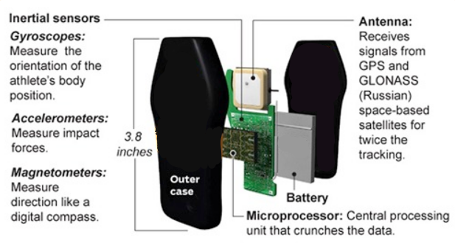
Challenge 1 - Smart wearable to track and record the players movement in real time using GPS.
For recording the movements of the players we use inertial sensors which are made up of an accelerometer to measure force and acceleration, a gyroscope to give an indication of rotation, and a magnetometer to measure body orientation. These sensors collect data across three axes and capture player’s movement in minute detail.
A microcontroller is present in the device which is integrated with cloud to record the movements of the players so it can be playback to understand the players performance.
The prototype we will be providing is a hardware which will be a wearable device which will monitor even the minute detail of the player. Cloud is being used to store the data. So that it can be played back to understand the performance of the player.

Slide 5
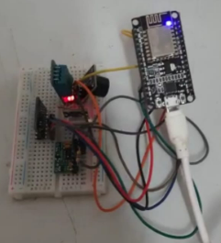
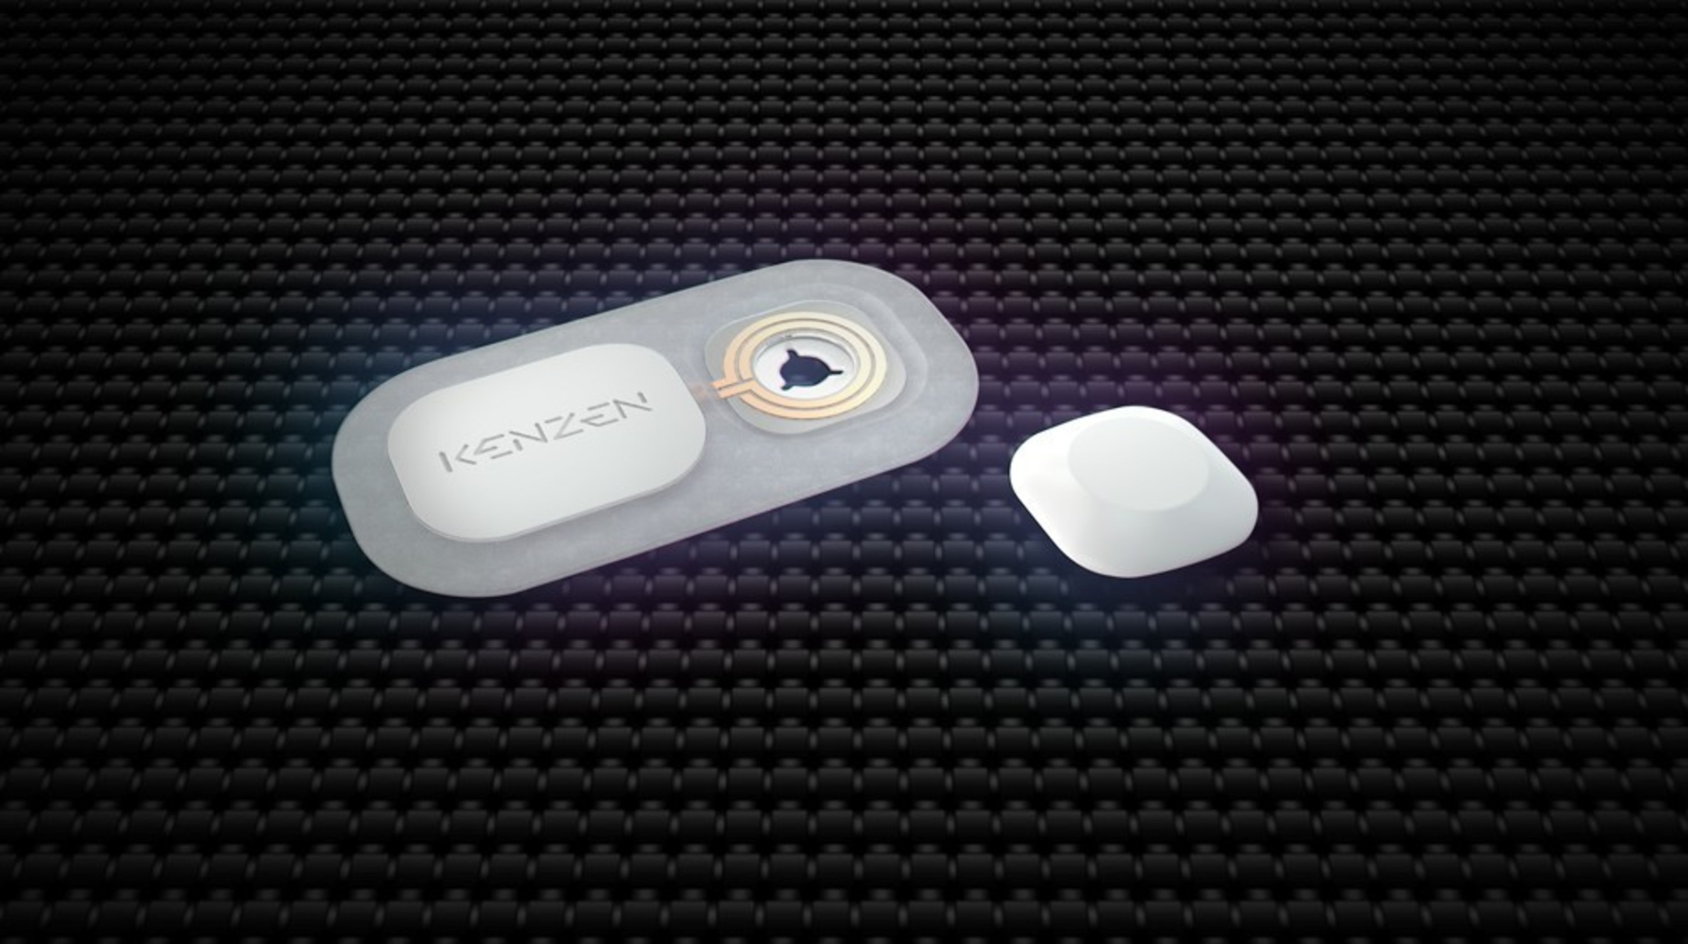
Challenge -3 - Find the player’s health (tiredness) and inform the coach
We use the following sensors for measuring the following parameters.
Max30100 – pulse oximeter :Heart rate, oxygen saturation and body temperature
Lactic acid monitor (echo h2) – for measuring the tiredness.
We have done a prototype for measuring the heart rate, pulse and temperature using the max30100 sensor which will monitor the body for every 0.5s accurately. The microcontroller we have used is nodemcu. So if any abnormalities detected on the players health will immediately send a alert to the caretaker/coach. We have used 3 triggers in IFTTT in Webhooks. We have done the prototype for health monitoring.
Prototype done so far
Now moving on to the tiredness factor, when playing, the body produces lactic acid which causes pain and can generate muscle traumas which leads to tiredness. If the lactic acid level reaches to a scale then it affects the health. This wearable lactic acid monitor helps players to avoid overexertion. Training intelligently without suffering injury is easier than ever.

Slide 6
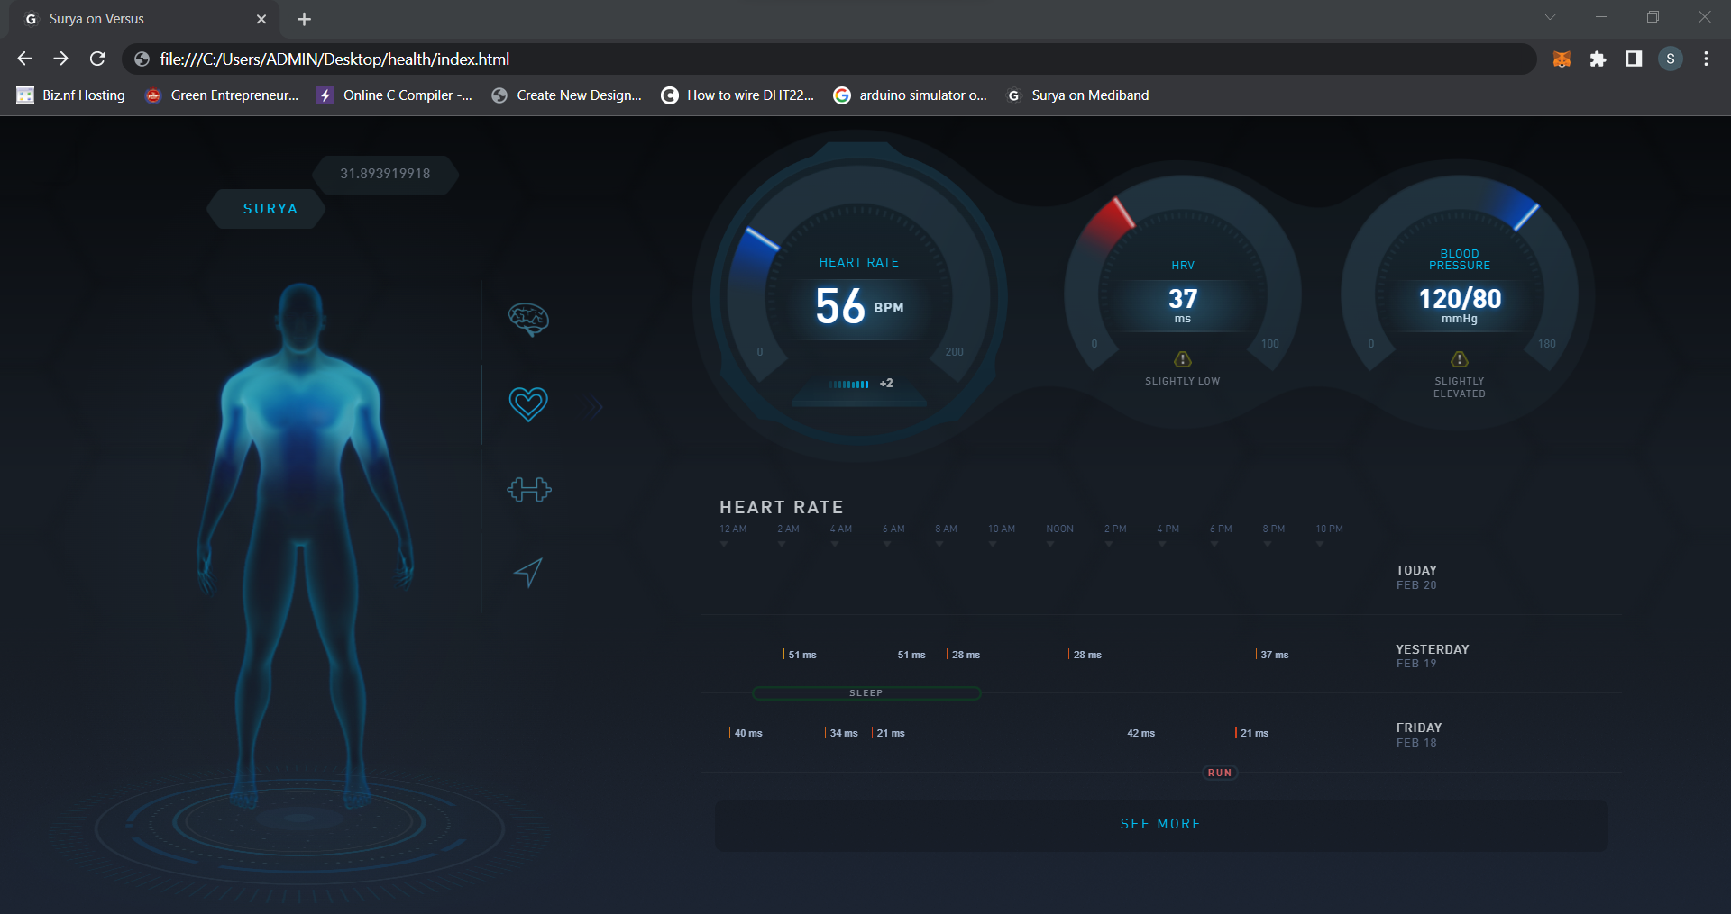
Challenge 4- Hockey dashboard - Cloud/Web-based software
We are developing a website in which the organizers can perform some activities. The added feature other than the given is the player’s health which can be lively monitored through the website by the coach or the care taker. We have started developing the website. As now, we are planned to develop the website using the following.
Frontend – HTML, CSS, Mapbox JS.
Backend – MongoDB. (PHP – for login alone).
As we are web-developers, we have experience in developing a
website. We have completed the player’s health page.
Now we are developing hockey dashboard and we will be
developing as a complete functional website soon including backend.
Website done so far for health

